Slide 1
High School Intro 101
Tools + Resources for HS success

Slide 2
Objectives
By the end of this lesson, you will learn:
Who the School Counseling Team is and their role.
Strategies to support you throughout high school.
Ways to get involved in school community.
Resources available to you in the school community.
Technology tools that you will need to navigate high school.

Slide 3
Mindful Minute
Notes:
Us this mindful minute to regroup and center before starting

Slide 4
Carlmont’s Counseling Dept. Team
Ms. De Paoli - Dept. Chair + AVID program
Ms. Miller - BTI Counselor
Ms. Vernon
Mr. Yokomura
Dr. Dominguez
Ms. Ibarra
Mr. Ledesma
Ms. Smith
Ms. Torres
Intervention Counselor -
Cielo Calpotura Wagner
Crisis Counselor/S.O.S. Coordinator -
Shelley Bustamante
College/Career Coordinator - Nina Rasor
School Registrar - Irma Abelt
Guidance Information Specialist - Yvonne Chamorro + Elizabeth DeSpain

Slide 5
What is the role of a High School Counselor?
Think-Pair-Share
I go to my School Counselor to get help with…
My School Counselor's job might include…

Slide 6
Role of a School Counselor
Do’s | Don’t
Academic Planning Graduation Status Course planning for college or career pathways College and Career Career Exploration Goal Setting Career Planning Social/Emotional Safe space to express feelings Submit referrals for counseling Connecting to community resources | Discipline Attendance Work Permits Supervision Provide therapy or long term counseling
Notes:
Q4 on Pre/post

Slide 7
Counselor Confidentiality

Slide 8
Coping Strategies
Notes:
Examples of what a counselor may teach you to help with stress or social concerns that may come up in high school

Slide 9
Engage in activities that you find calming
Utilize strategies such as mindfulness
& meditation
In addition to your School Counselor, speak to a trusted adult:
your parent/guardian
your teacher(s)
AVP + Administrative staff
Health Office staff
your doctor
Notes:
Next we will do one together and start practicing now

Slide 10
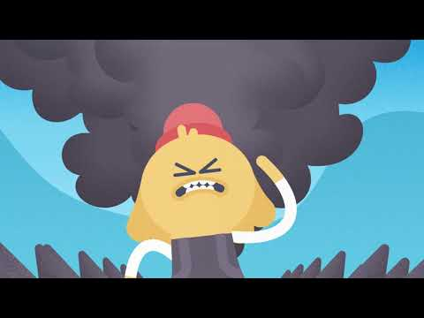
Meditative Brain Break
Notes:
This can be 1 of many coping strategies - lookup meditative videos available on youtube for a quick minute

Slide 11
What are some coping strategies you use?
Think-Pair-Share

Slide 12
Resources

Slide 13
Student Resources
Social/Emotional -
School Counseling office
Mental Health Office -
Ms. Bustamante
Ms. Calpotura-Wagner (CW)
Health Office
AVP
Academics -
College and Career Center
Library - Academic Tutoring Center
Peer Tutors
Academic Clubs on campus
Flex Time
Paper Tutoring (in Canvas)
Boys and Girls Club

Slide 14
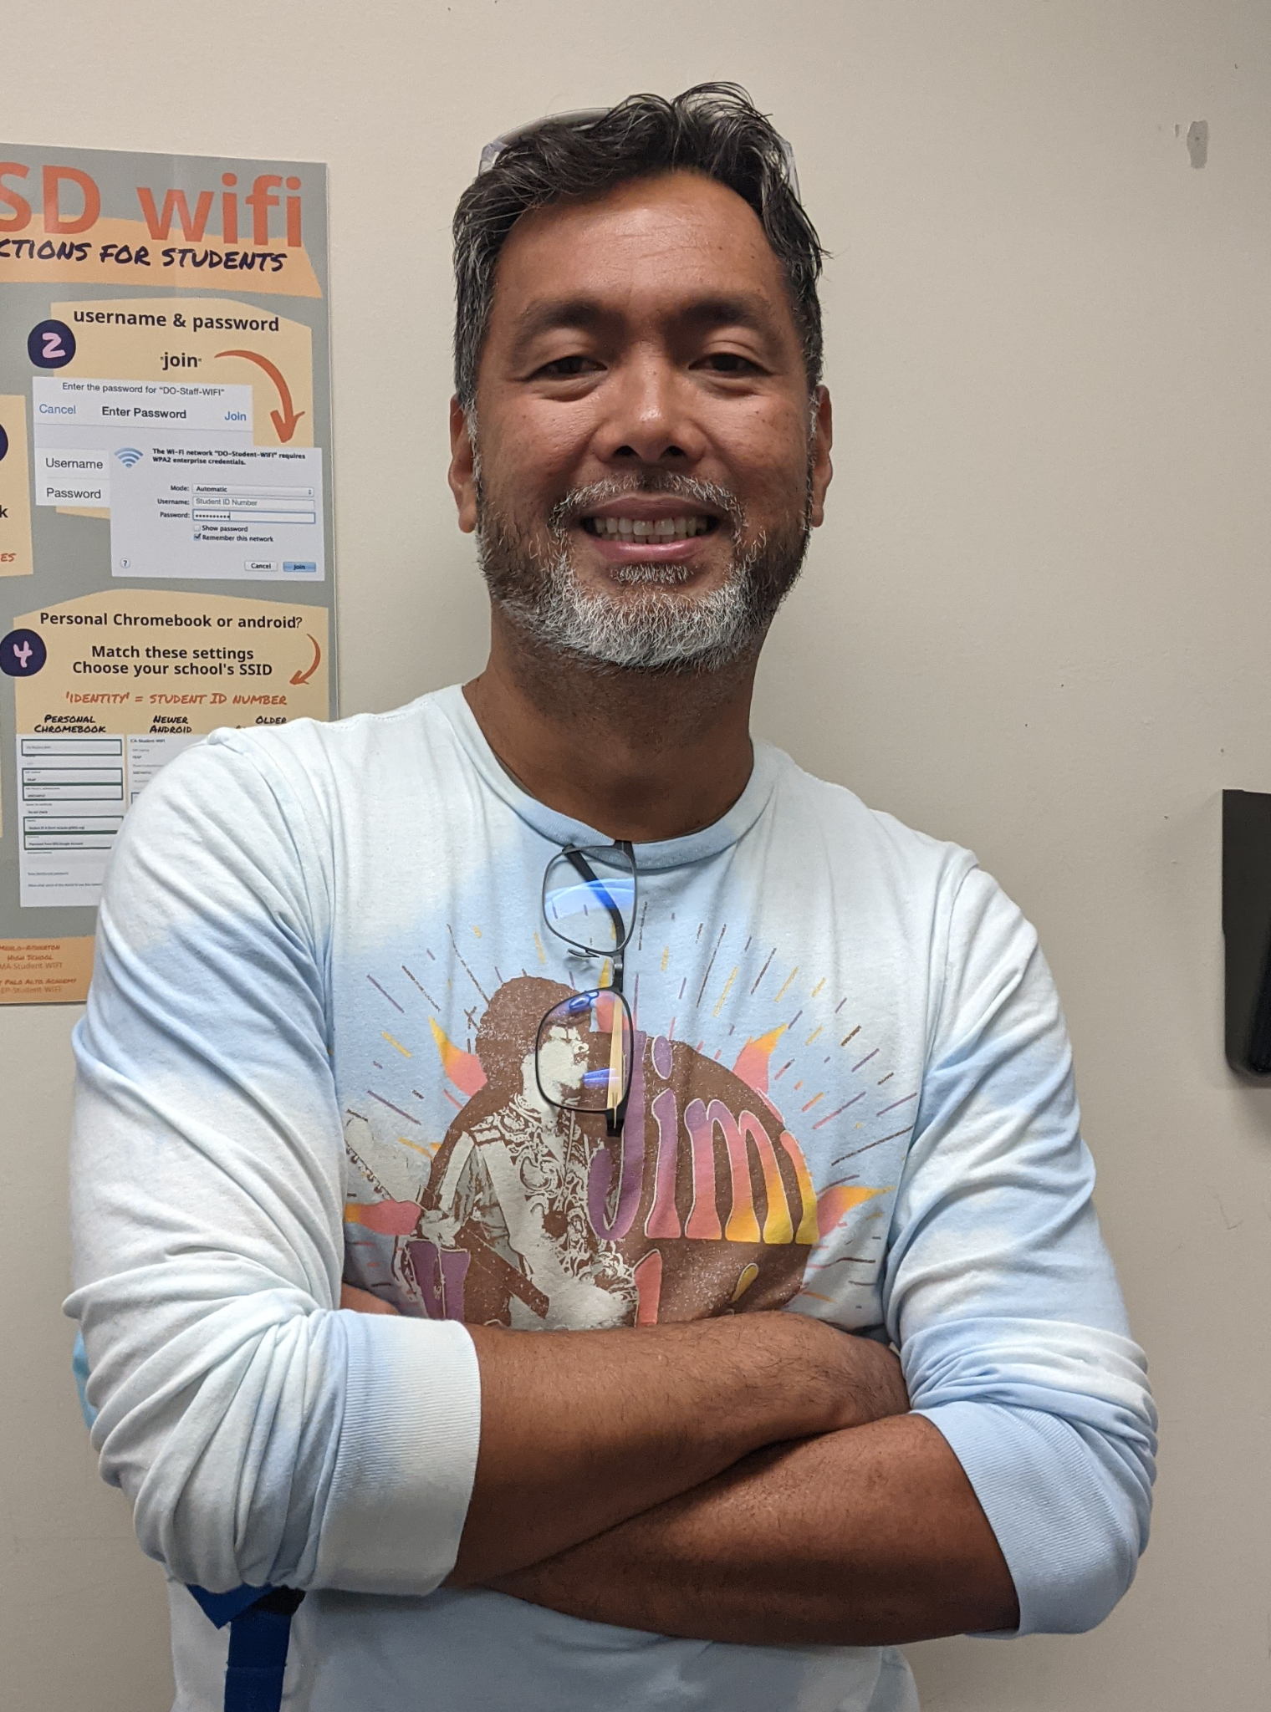
Academic Support

Slide 15
School Involvement & Extracurricular Activities

Slide 16
What are some ways to get involved?
Think-Pair-Share

Slide 17
Ways to get involved…
Students who are involved in some form of extracurricular activity perform better in school.
Sports
Volunteer
Clubs
Special Projects
Special Programs - BTI, Journalism, etc.
Governance Council
Advocacy Opportunities
Theatre programs
Art programs
Music
ASB/Leadership
Special campus events
College and Career Presentations
Science Lecture Series
Student Activities Calendar
Notes:
Do not spend too much time on this slide!

Slide 18
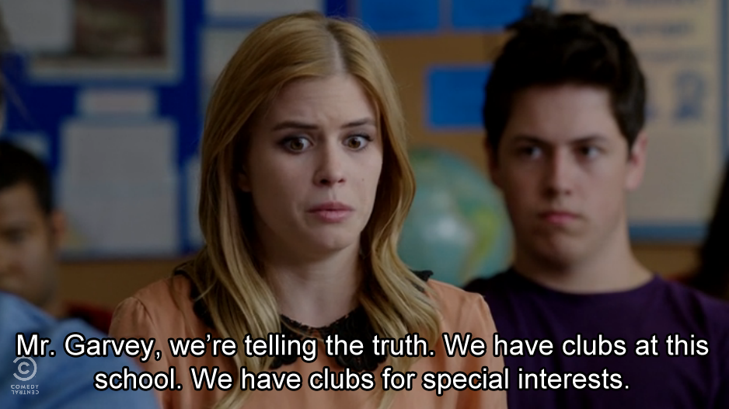
Importance of Getting Involved
1. Discover new possibilities.
2. Ease transitions.
3. Relieve boredom.
4. Relieve academic pressure.
5. Increase academic performance.
6. Build important skills.
7. Make connections with new people.
8. Build your job resume.
9. Find others with similar interests.
10. HAVE FUN!! : D
Notes:
Q2 & Q3 on pre/post

Slide 19
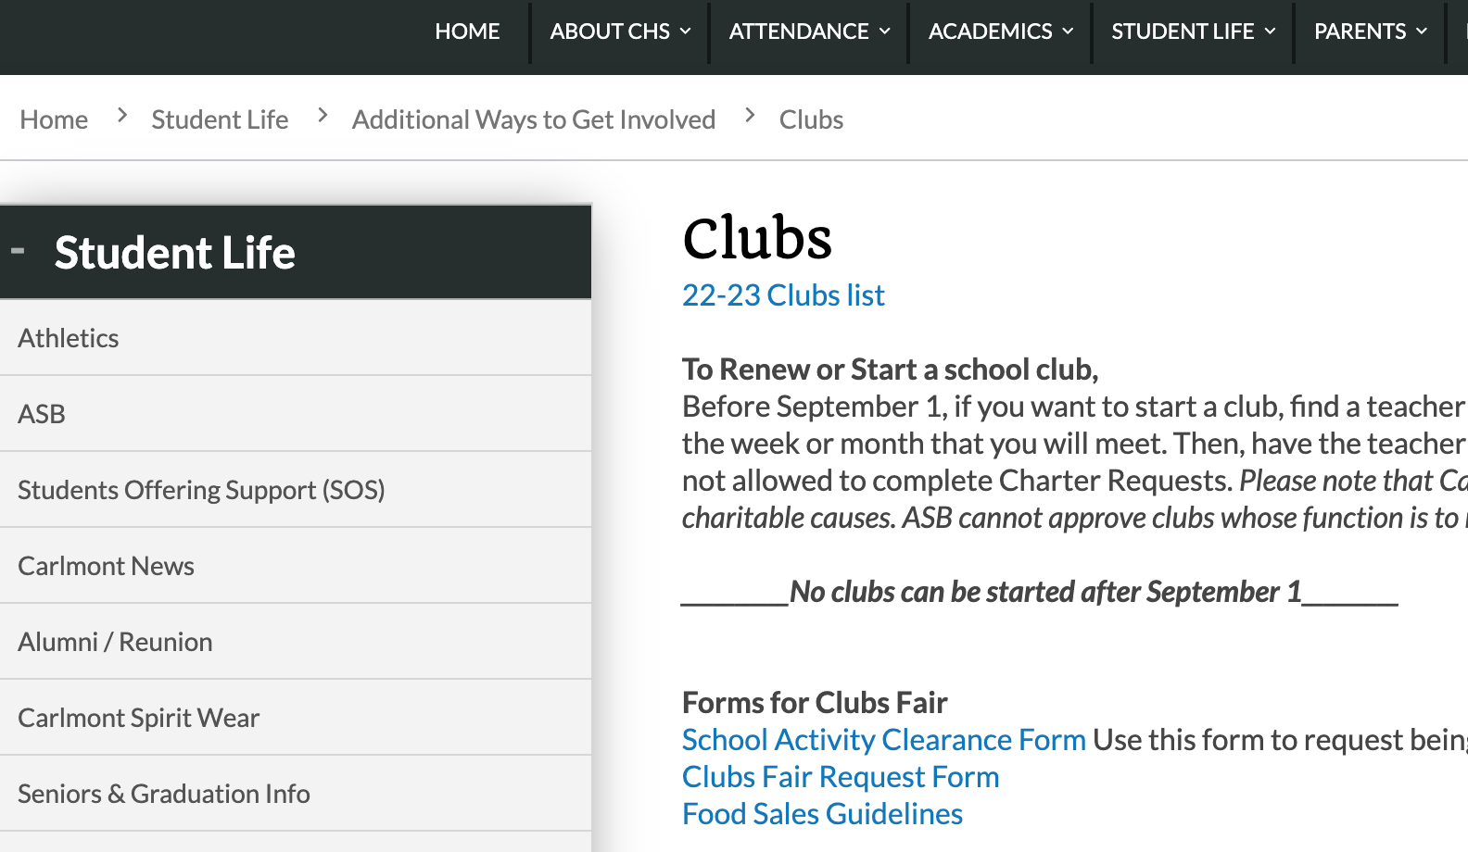
Clubs
Some examples 131 clubs on campus–
Pacific Automotive Club
Pets in Need Club
Healthy Living Club
CAFE - Carlmont Athletes for Equality/Equity
Self Defense for Girls Club
Investment Club
Green Team
As well as many other academic and cultural clubs…
Notes:
Make it a screenshot rather than a link

Slide 20
Getting Involved in Sports
Fall
Winter
Spring
Water Polo
Cross Country
Girl’s Golf
Football
Girl’s Tennis
Girl’s Volleyball
Cheer
Girl’s Soccer
Boy’s Soccer
Girl’s Basketball
Boy’s Basketball
Wrestling
Cheer
Badminton
Track
Boy’s Tennis
Boy’s Volleyball
Baseball
Lacrosse
Softball
Swimming
Cheer
Go to Carlmont’s SCHOOL website to complete the Athletic Clearance Packet (English) Athletic Clearance Packet (Spanish)

Slide 21
Technology Tools

Slide 22
Infinite Campus
School Email
School Website
Canvas
Used for checking:
Schedule
Grades
Unofficial Transcripts
Attendance
Finding out who YOUR counselor is
Make sure to check your school email often (at least once a day)
**Perfect way to communicate with your counselor!
Consider exploring:
School Counseling Department Page
College & Career Center Page
Student Activities Page
Clubs
Athletics
Work Permit information
Campus calendar and events
ASB website
Bell Schedule
Used for:
Homework & classroom assignments
Viewing your most up-to-date grades & progress
Checking your calendar
Emailing teachers
Notes:
Maybe add more school website consideration points?

Slide 23
Technology Scavenger Hunt Activity
Go to Club List and choose ONE Club that’s interesting.
Using Infinite Campus go to “Documents” and “Progress Report”. https://ic.seq.org/campus/portal/sequoia.jsp
Based on your Canvas grades, what is a class you need more academic support? https://sequoia.instructure.com/login/ldap
Where is ONE place you can find academic support?
Notes:
Connects to Q1 on pre/post

Slide 24
Graduation Requirements
Aim for C-
or higher
Life Skills - 2.5 credits
English 4 years
Social Studies - 37.5 credits
Ethnic Studies, World History, US History, Govt/Econ
Math - 2 years
Science - 2 years (Life + Physical)
Fine Art - 1 year
P.E. - 2 years
Career Tech Ed. (CTE) - 1 year
Electives - 60 credits
Total: 220 credits
Notes:
Mention that they receive credits for a D, but want them to aim for a C

Slide 25
Final Thoughts

Slide 26
Freshman Year Checklist
Get involved in clubs, sports, and/or community service
Discover your passions and interests
Aim for C- or higher in all of your classes
Do well in classes by:
Contacting your teacher
Going to tutoring
Studying
What’s the best way to contact your School Counselor?
Send an email!! (or drop in before school, lunch or after school)

